Slide 1
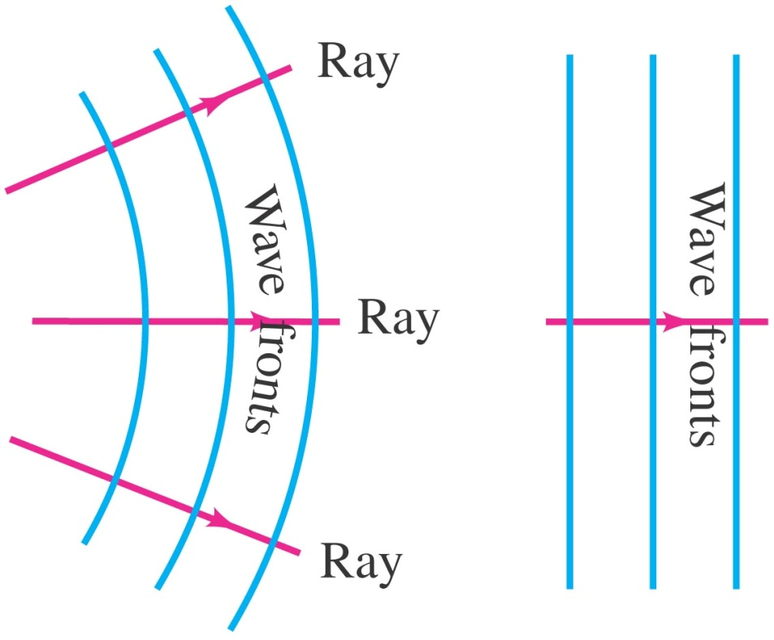
Wave fronts
Two- or three-dimensional waves can be represented by wave fronts, which are curves of surfaces where all the waves have the same phase.
Lines perpendicular to the wave fronts are called rays; they point in the direction of propagation of the wave.

Slide 2
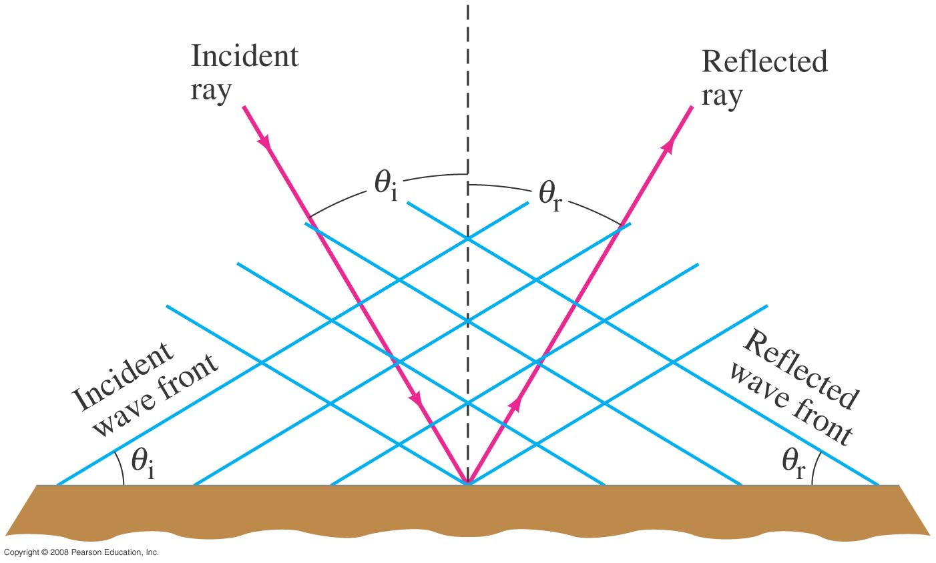
Reflection and Transmission
The law of reflection: the angle of incidence equals the angle of reflection.

Slide 3
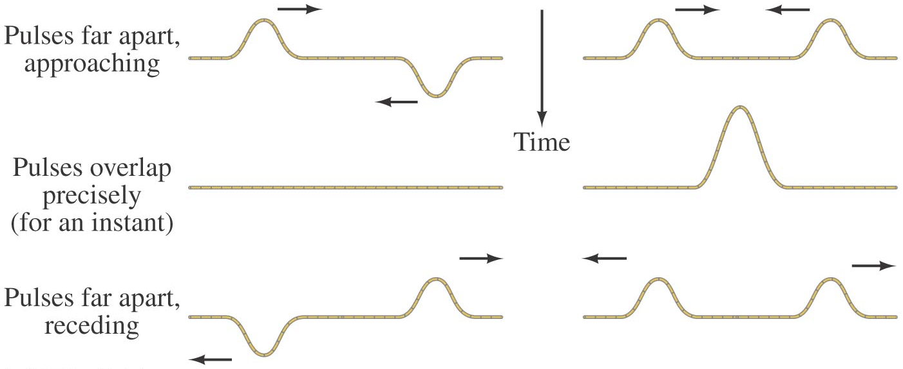
Interference
The superposition principle says that when two waves pass through the same point, the displacement is the arithmetic sum of the individual displacements.
In the figure below, (a) exhibits destructive interference and (b) exhibits constructive interference.

Slide 4
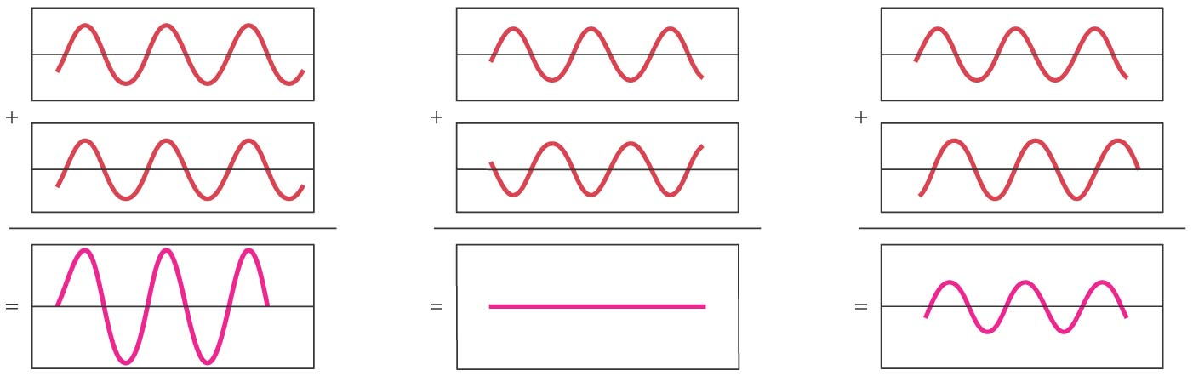
Interference
These graphs show the sum of two waves. In (a) they add constructively; in (b) they add destructively; and in (c) they add partially destructively.

Slide 5
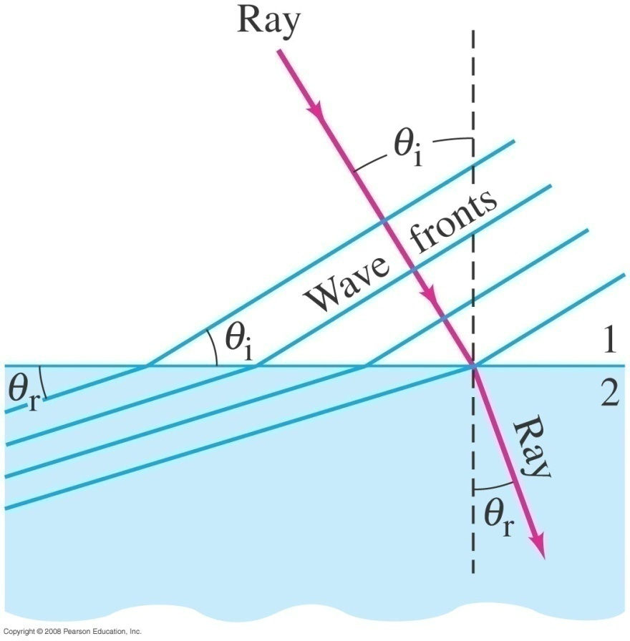
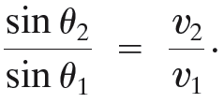
Refraction
If the wave enters a medium where the wave speed is different, it will be refracted—its wave fronts and rays will change direction.
We can calculate the angle of refraction, which depends on both wave speeds:

Slide 6
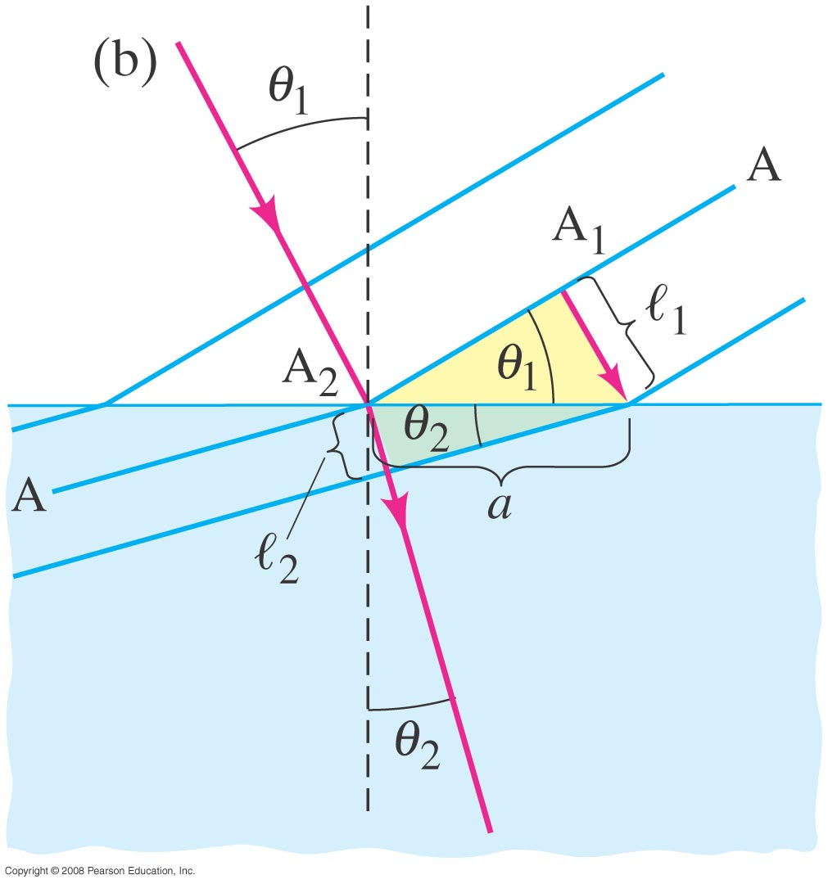
Refraction
The law of refraction works both ways—a wave going from a slower medium to a faster one would follow the red line in the other direction.

Slide 7
Refraction
Refraction of an earthquake wave.
An earthquake P wave passes across a boundary in rock where its velocity increases from 6.5 km/s to 8.0 km/s. If it strikes this boundary at 30°, what is the angle of refraction?
Notes:
Solution: Applying the law of refraction gives the angle as 38°.

Slide 8
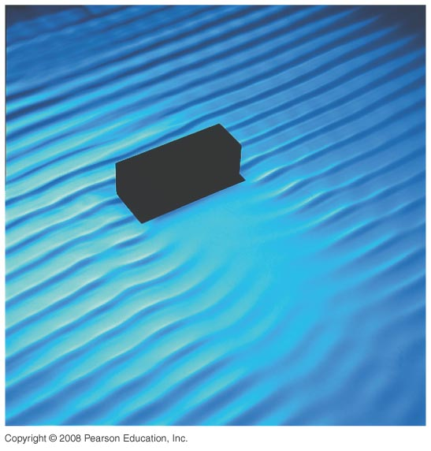
Diffraction
When waves encounter an obstacle, they bend around it, leaving a “shadow region.” This is called diffraction.

Slide 9
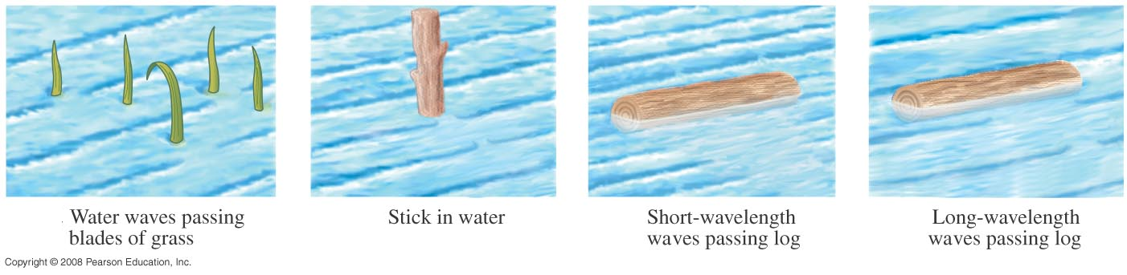
Diffraction
The amount of diffraction depends on the size of the obstacle compared to the wavelength. If the obstacle is much smaller than the wavelength, the wave is barely affected (a). If the object is comparable to, or larger than, the wavelength, diffraction is much more significant (b, c, d).

Slide 10
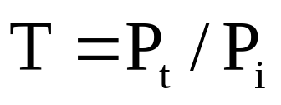
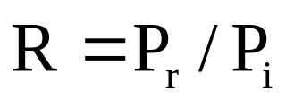
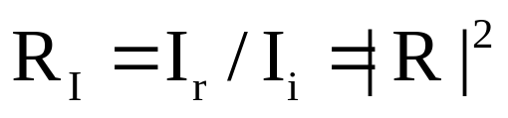
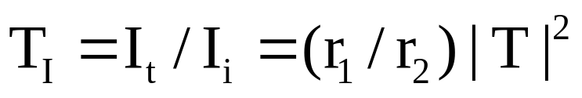

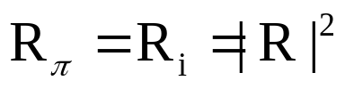
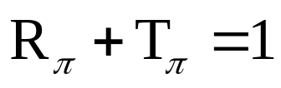
Sound Transmission
P_{t} → transmitted wave Pressure
P_{i} → incident wave Pressure
Pr → reflection wave Pressure
A. Pressure transmission and reflection coefficients
I=P²/2r
B. Intensity transmission and reflection coefficients
C. Power transmission and reflection coefficients
All the ratios depend on
  the characteristic acoustic impedances,
  speed of sound in the two media and
  on the angle of incident wave makes with the interface.

Slide 11


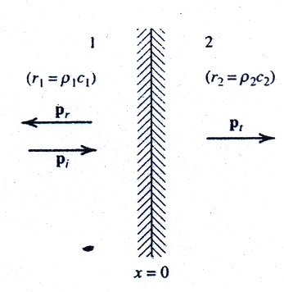

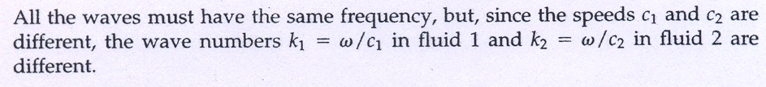
Normal Incidence:
Transmission from one fluid layer to another
r₁ and r₂ are the characteristic acoustic impedance of fluid 1 and fluid 2 resp.

Slide 12






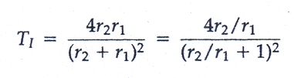
Boundary conditions:
The acoustic pressure on both sides of the boundary must be equal
The normal components of the particle velocities on both sides of the boundary must be equal.
1+R=T

Slide 13
Normal Incidence:
Cases:
r₁ < r₂ : R (+ve) T (+ve)
r₁ > r₂ : R (-ve) T (+ve)
r₁ = r₂ : R (0) T (+ve) (Complete transmission condition)
r₁/ r₂ → 0 : The wave is reflected with no reduction in amplitude and no change in phase.
  “ The boundary is term as RIGID”.
r₁/ r₂ →∞ : The amplitude of the reflected wave is again equal to that of the incident wave,
  and the transmitted wave has zero pressure amplitude.
  The boundary is termed as PRESSURE RELEASE.

Slide 14
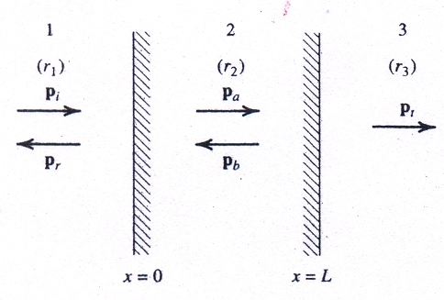





Normal Incidence
Transmission through a fluid

Slide 15
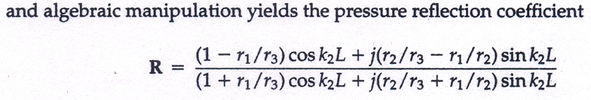



Special Forms of above equation which are of particular interest:
If the final fluid is same as the initial fluid, r₁ = r₃ ,
If, in addition, r₂ >> r₁,
This is applied to the transmission of sound from air in one room through a solid wall into air in an adjacent room.

Slide 16

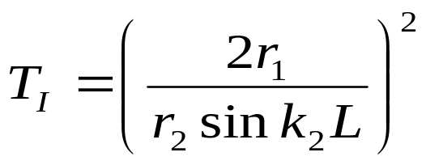
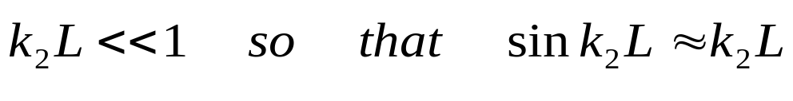
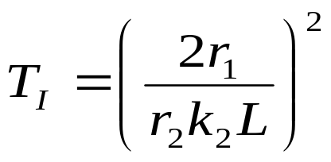


For all reasonable frequencies and thicknesses of wall
Except those of high frequency and very thick wall
then
Transmitted pressure is inversely proportional to the thickness L
For thin panels or low frequency

Slide 17


The intermediate fluid has a larger characteristic impedance than either fluid 1 or fluid2 but such a small thickness that
A thin membrane of solid material of appropriate characteristic impedance may be used in
  preventing two gases or two liquids from mixing and
  yet not interfere with sound transmission between them.
In particular, if r1 = r3 then
  there is total transmission from fluid 1 to fluid 3 as if fluid 2 did not exit.

Slide 18



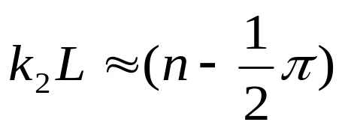

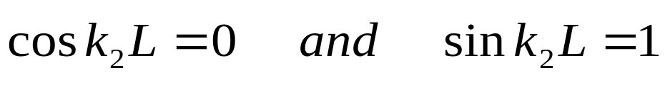
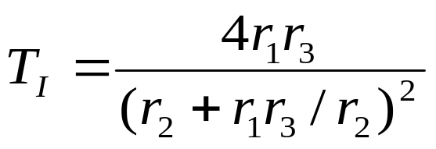
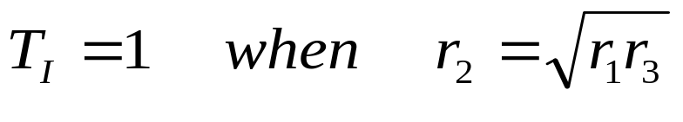
3. If
Reduce to
4. If

Slide 19
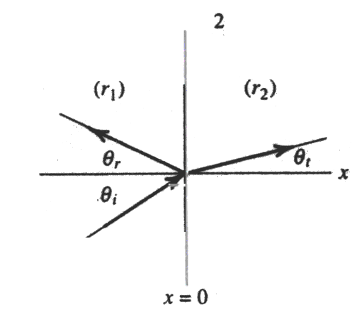
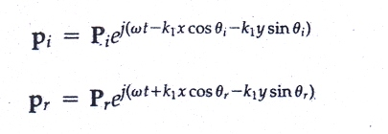
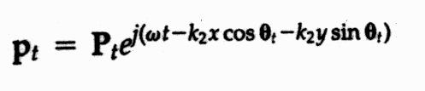




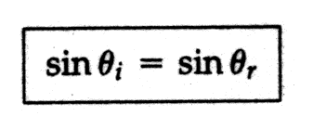
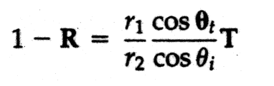

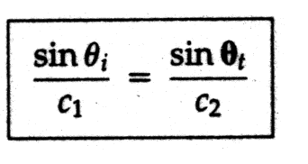
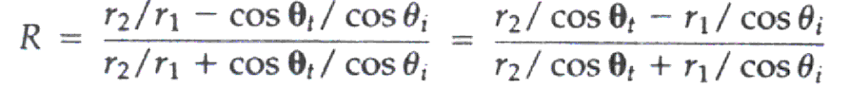
Oblique Incidence:
Transmission from one fluid layer to another
Applying continuity of pressure at the boundary x = 0,
Snell’s Law

Slide 20
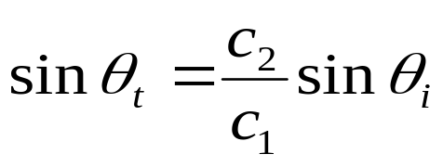
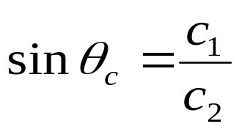
If c₁>c₂ the angle of transmission is real and less than angle of incidence → the transmitted beam is bent towards the normal for all angle of incident.
B. If c₁<c₂ and angle of incidence is less than critical angle θ_{c}→ transmitted beam is bent away from the normal for all angle of incident.

Slide 21
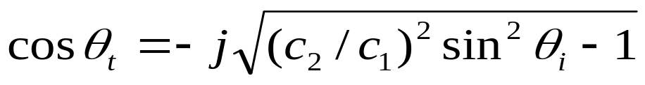
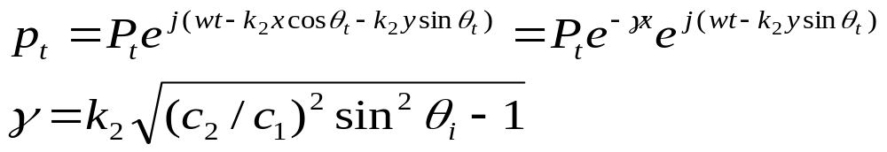
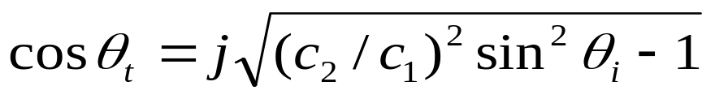

If c₁<c₂ and angle of incidence is grater than critical angle
sinθ_{t}
Is real and greater than unity
cosθ_{t}
Is pure imaginary
Transmitted wave propagate in y direction , parallel to the boundary
The amplitude that decays perpendicular to the boundary
if
then
negative
The amplitude that increased perpendicular to the boundary with increasing x

Slide 22
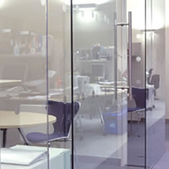

Mass Law
Practical importance
  Architectural acoustics is the transmission of sound through a thin partition between two enclosures
    As found in many office or temporary working spaces.
Continuity of the normal component of particle velocity is equivalent.

Slide 23
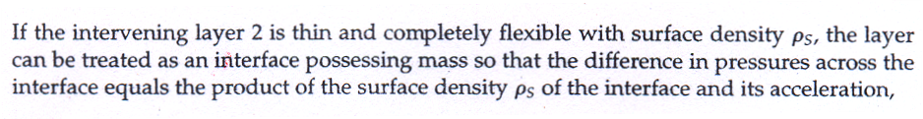
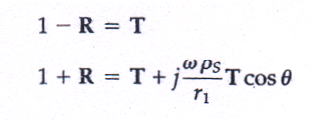

Mass Law
For an incident wave failing normally on the surface, reduces to the equivalent case given by
With fluids 1 and 3 having the same characteristics impedances and fluid 2 a thin layer with r₂>>r₁.

